Slide 1

Voice Coding: VC-WA01
A project proposal for a voice-controlled web application that converts spoken commands into valid C++ code.

Slide 2

Project Overview
Project Team
Advisors
Alina Ahmed (Team Lead)
Mudassir Ali Zaidi
Maryum Javed (Team Member)
Dr. Muhammad Ilyas (Project Manager)
Laiba Humayun (Team Member)
Submission
January 7, 2026
University of Sargodha

Slide 3

Abstract: Bridging the Coding Gap
Traditional programming relies heavily on keyboard use, creating barriers for individuals with physical disabilities or repetitive strain injuries. Our voice-controlled web application aims to solve this by converting spoken commands into C++ code, enabling real-time compilation without keyboard dependency.
Inclusive Education
Reduced Physical Barriers
Provides accessible programming tools.
Enables hands-free coding for all.
Enhanced Accessibility
Zero-cost, web-based platform.

Slide 4





Implementation Steps
Web Interface Design
Integrated code editor.
Voice Recognition
Using Web Speech API.
C++ Command Parser
Develop specific parser.
Cloud Compilation
Integrate services.
Usability Testing
Conduct thorough tests.

Slide 5

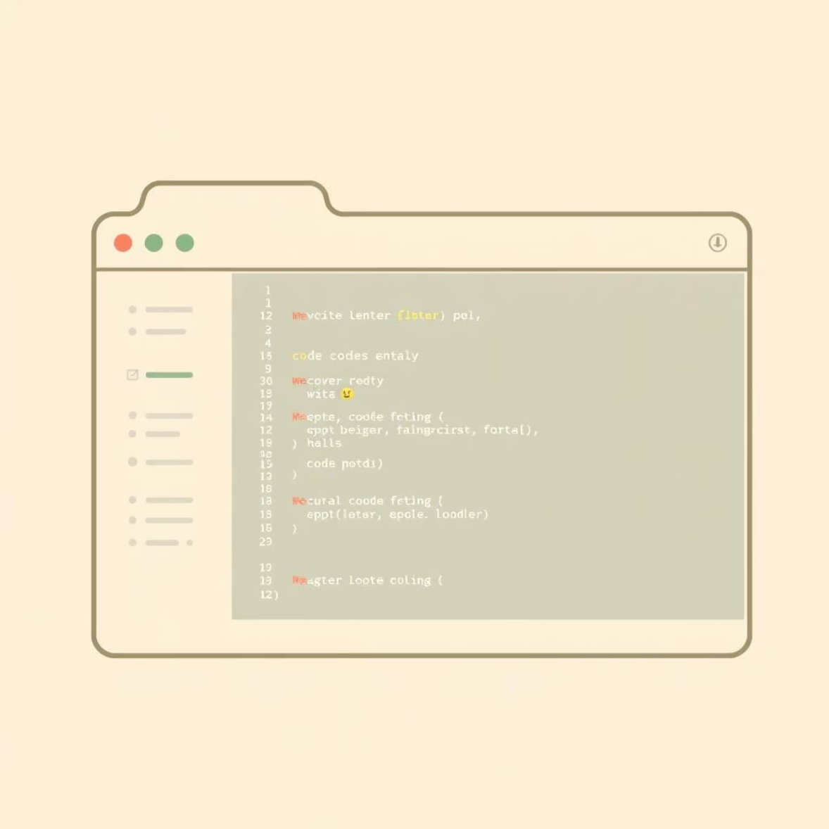
Background & Justification
Existing Work
Our Enhancement
Current programming environments rely on keyboard input. Some voice tools exist but require payment, complex setups, or local installations, limiting accessibility.
Our web-based solution requires no installation or payment, using free APIs. We focus on C++ education with optimized voice commands for common constructs.
This project addresses a critical gap by providing a zero-cost, web-based platform for voice-controlled C++ coding, enhancing accessibility and eliminating financial/technical barriers.

Slide 6
Project Methodology: Iterative Development
We will follow an iterative and incremental development model, ensuring each feature is built, tested, and refined step-by-step.
01
02
03
Phase 1: Interface Design
Phase 2: Speech Recognition
Phase 3: Command Parsing
HTML, CSS, JavaScript for web interface, code editor, microphone controls, output console.
Web Speech API converts voice to text for commands like "include iostream".
Custom JavaScript parser maps recognized text to C++ syntax (e.g., "if x greater than y" → if (x > y) {}).
04
05
Phase 4: Code Compilation
Phase 5: Testing & Improvement
Paiza.io or JDoodle APIs execute C++ code in the cloud, returning output.
Individual feature testing, user testing for accuracy, correctness, and response time.

Slide 7


Project Scope
In Scope
Out of Scope
Real-time voice-to-code conversion
Multiple programming languages (C++ only)
Integration with free cloud compiler APIs
Offline voice recognition
Syntax highlighting & command mapping
Complex AI-based NLP
Browser-based execution (no installation)
Accessibility for physical disabilities

Slide 8
High-Level Project Plan: Milestones
M1: Foundation & Setup
1
Kickoff, repo, web scaffold, Monaco Editor, Web Speech API prototype.
2
M2: Voice Recording & Basic Commands
Voice capture, transcription, basic command parsing.
M3: Advanced Command Processing
3
Control structures, functions, templates, voice-driven code generation.
4
M4: Integration & End-to-End Flow
Compilation API, "Compile & Run", error handling, UI polish.
M5: User Experience Enhancements
5
Command help, syntax highlighting, undo/redo, tutorial mode.
6
M6: Advanced Features
Context-aware parsing, auto-completion, command history, customization.
M7: Testing & Optimization
7
Accents, browser testing, performance tuning, bug fixes, stress tests.
8
M8: Documentation & Final Presentation
Comprehensive docs, user manual, demo video, final report.

Slide 9





Resource Allocation & Success
Time Allocation
Success Metrics
Core C++ Coverage
Planning & Design
Frontend Development
Voice Processing
Voice-to-code for basic C++ constructs.
Integration & Compilation
UX & Accessibility
Testing & Debugging
Documentation & Presentation
High Accuracy
Robust voice recognition and error handling.
Complete Documentation
User manual and demo-ready presentation.

Slide 10
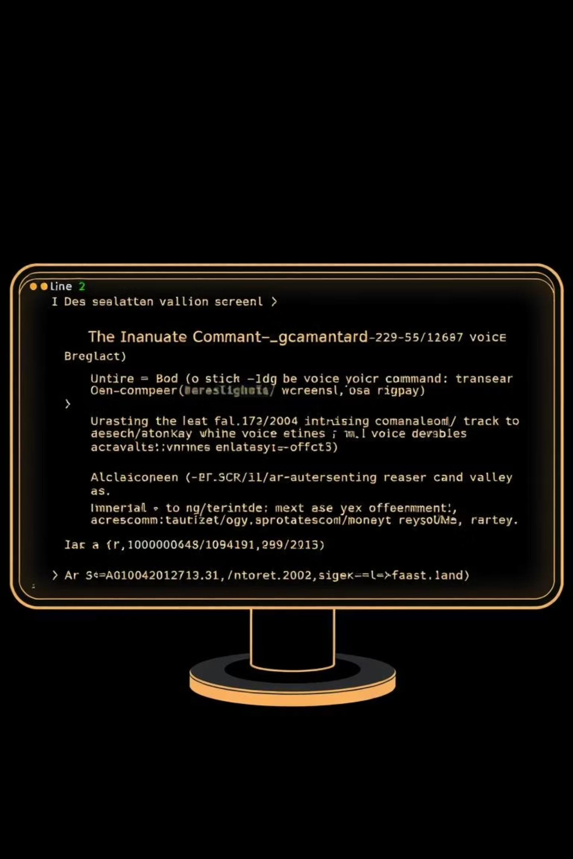
Voice Coding: VC-WA01
Software Requirements Specification

Slide 11
Key Definitions
API
Web Speech API
Monaco Editor
Application Programming Interface for system communication.
Browser feature for speech recognition.
Code editor component from VS Code.
RSI
SRS
Repetitive Strain Injury.
Software Requirements Specification.

Slide 12


Project Introduction & Purpose
Purpose of Document
Project Overview
This SRS defines functional and non-functional requirements for the Voice Coder web application, structured by IEEE Std 830-1998. It guides stakeholders, developers, and evaluators on project functionality, limitations, and design goals.
Voice Coder is a web app for C++ programming via voice commands. It translates spoken instructions into C++ code, compiles it, and displays output. Aims to improve accessibility for users with physical disabilities or RSI and promote hands-free programming.

Slide 13


Scope of Voice Coder
The system WILL:
The system WILL NOT:
Convert voice commands to C++ code using Web Speech API.
Support languages other than C++.
Support basic to intermediate C++ constructs.
Offer advanced IDE features (debugging, version control).
Provide real-time cloud-based compilation via Paiza.io or JDoodle APIs.
Work offline or in languages other than English.
Handle complex C++ metaprogramming.
Display program outputs and errors.
Operate on modern browsers without installation.

Slide 14





System Environment & Users
Primary Users
Students with disabilities, programmers with RSI, and computer science educators.
Secondary Users
Accessibility researchers and developers in voice-based programming.
Hardware
PC, Laptop, or Tablet with a microphone.
Browser
Chrome 70+, Firefox 75+, Edge 79+, Safari 13+ (supporting Web Speech API).

Slide 15





System Constraints & Dependencies
Internet & Browser
Requires stable internet and browser support for Web Speech API.
Language Limitations
Limited to C++ features supported by chosen cloud compiler API.
Hardware & Environment
Needs microphone, 2GB RAM, quiet environment, and clear English speech.
API Reliability
Depends on availability and reliability of external APIs.

Slide 16
Functional Requirements
01
02
Voice Command Recognition
Command Parsing & Code Generation
Capture voice input and convert to text using Web Speech API.
Interpret recognized text into predefined C++ templates.
03
04
Code Display & Editing
Code Compilation & Execution
Display recognized code in Monaco Editor for manual edits.
Send code to cloud compiler API for execution and retrieve output/errors.
05
06
Error Handling
User Interaction & Accessibility
Display clear messages for invalid commands, network issues, or compilation errors.
Accessible "Start Recording," "Stop," and "Run Code" buttons.

Slide 17








Non-Functional Requirements
Safety
Performance
Execute C++ code in secure cloud sandbox, no local execution or file access.
Process commands in 2-4s, 90-95% speech accuracy, 5s code execution.
Security
User Documentation
HTTPS/TLS encryption, OWASP Top 10 compliance, no user data storage/sharing.
Comprehensive web-based manual, updated iteratively (agile principles).

Slide 18
Assumptions and Dependencies
Stable Internet Access
Web Speech API Compatibility
External API Reliability
Users require a reliable internet connection for both speech recognition (Web Speech API) and cloud-based code compilation (Paiza.io/JDoodle APIs).
System performance is directly dependent on the consistent availability and uptime of third-party cloud compilation APIs.
The system assumes the user's browser (e.g., Chrome, Edge, or Firefox latest versions) fully supports the Web Speech API.
C++17 Standards
Iterative Development
The internal parser logic is specifically designed and optimized to interpret and generate C++ code compliant with the C++17 standard.
The project's development methodology relies heavily on iterative testing and continuous refinement, following established software engineering practices.

Slide 19

Software Design Specification: VoiceCoder
This document provides a comprehensive architectural blueprint and technical specification for the VoiceCoder web application, a project developed by Alina Ahmed, Maryum Javed, and Laiba Humayun.

Slide 20

Project Overview
VoiceCoder
VoiceCoder is an innovative web application enabling C++ programming through voice commands. It converts spoken natural language into syntactically correct C++ code, offering an accessible environment for individuals with physical disabilities or those seeking hands-free coding.
Voice-Controlled C++
Inclusive Environment
Cloud-Based

Slide 21
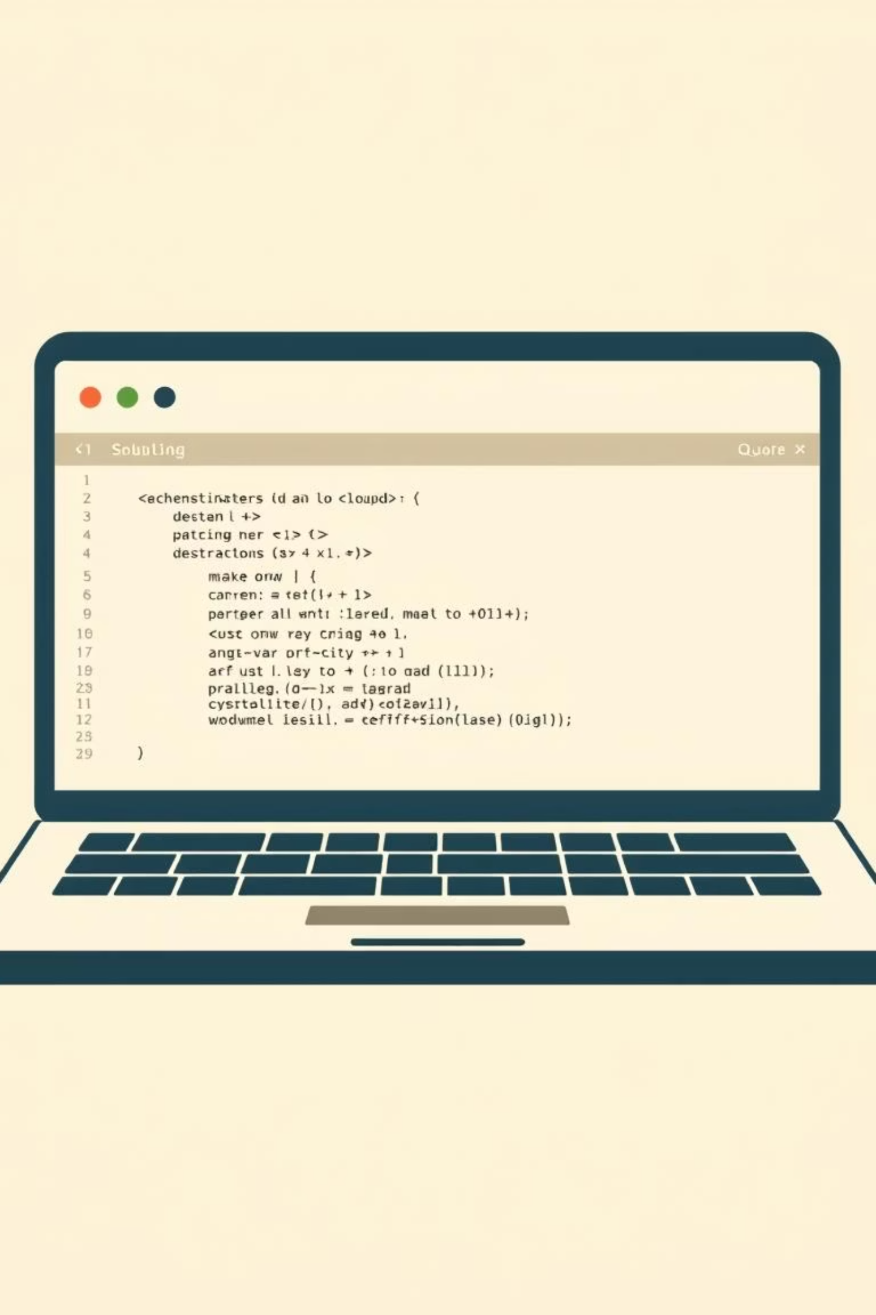
Scope of Features
In-Scope Features
Out-of-Scope Features
Voice-to-text for C++ commands
Other programming languages
Real-time code generation
Advanced IDE features (debugging)
Cloud-based C++ compilation
Basic C++ constructs support
Offline functionality
User authentication & saving
Complex C++ features
Cross-platform compatibility
Advanced NLP
Responsive UI design
Mobile app development
Error handling
Collaborative coding

Slide 22

Design Considerations
Assumptions
Dependencies
Users have modern browsers (JavaScript, Web Speech API), clear English commands, stable internet, a working microphone, and basic C++ knowledge.
Web Speech API, online compiler APIs (Paiza.io, JDoodle), code editor component, network availability.
Risks
Browser API deprecation, environmental noise affecting recognition, compiler API rate limits or downtime.

Slide 23
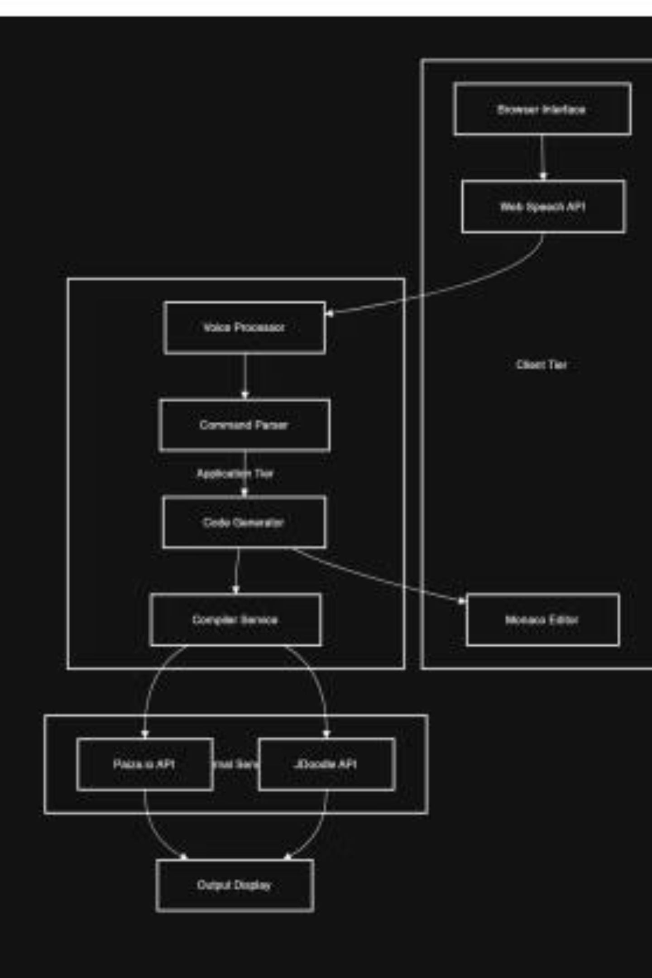
System Architecture: Overview
VoiceCoder employs a three-tier web application architecture: presentation, business logic, and data processing. This design ensures scalability, maintainability, and an optimal user experience.
Figure 3.1: VoiceCoder System Architecture Diagram showing the three-tier structure with client, application, and external service layers.

Slide 24
Component Interactions & Deployment
1
2
3
UI Layer
Voice Processing
Business Logic
HTML5, CSS3, JavaScript with Monaco Editor.
Web Speech API for recognition.
Command parser and code generator.
4
5
External Services
Data Management
Cloud compilation APIs.
Local storage for preferences.
Deployment uses static hosting for frontend, serverless functions for backend, and CDN for optimized asset delivery.

Slide 25

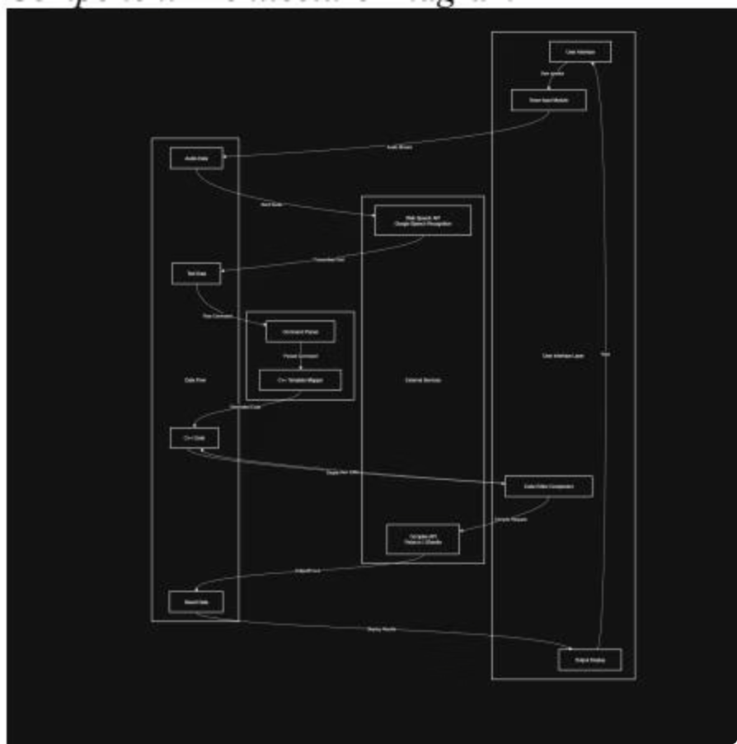
Sub-Component Architecture
VoiceCoder's modular design ensures maintainability and extensibility, with each sub-module performing a defined responsibility.
Speech Processing
Audio Capture, Speech Recognition Engine, Command Pre-Processor.
Parsing & Code Generation
Parser Core, Semantic Interpreter, Code Construction Engine.
Coding Interface
Monaco Rendering Module, Editor Interaction Layer.
Compilation & Output
Compiler API Handler, Execution Manager, Output Renderer.

Slide 26
Key Design Strategies
Modular Architecture
1
Isolates subsystems for easy updates and replacements.
Event-Driven UI
2
Ensures smooth handling of asynchronous operations and real-time feedback.
Rule-Based Parsing
3
Provides predictable and accurate C++ code generation.
Cloud-Sandboxed Execution
4
Prevents system-level threats from user-generated code.
Accessibility-First UI
5
Designed for users with RSI and physical disabilities.

Slide 27
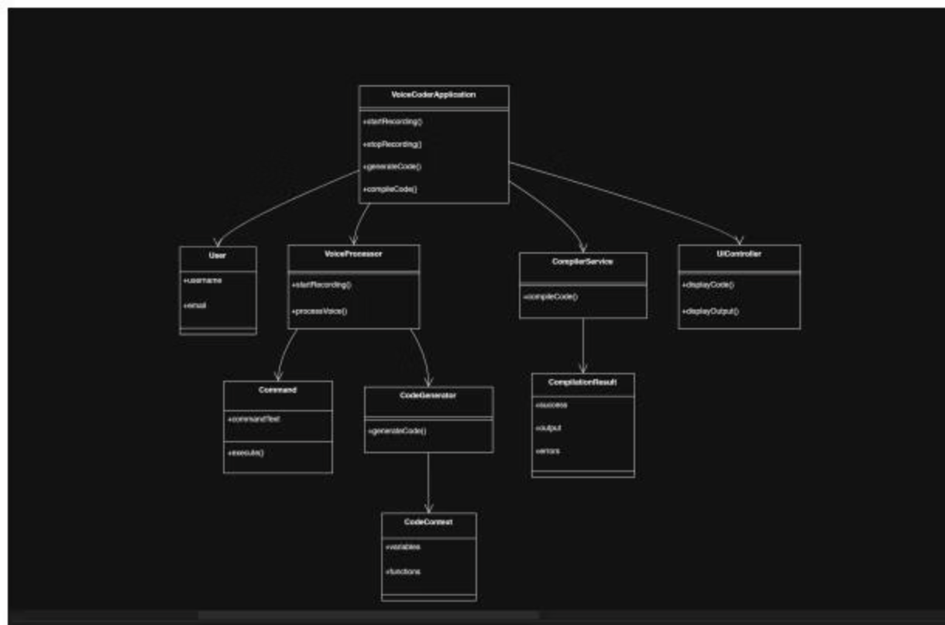
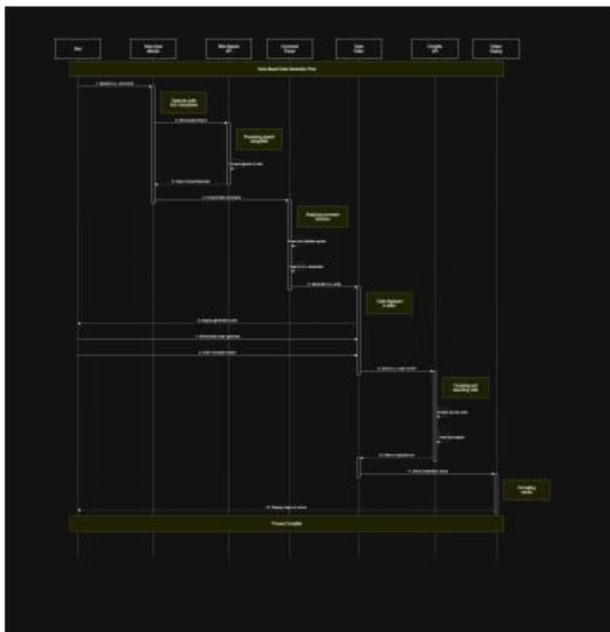
Detailed System Design: Classes & Flow
The VoiceCoder application is structured around core classes like VoiceCoderApplication, VoiceProcessor, CodeGenerator, and CompilerService, managing user interactions and code processing.
Figure 5.1: UML Class Diagram
Figure 5.2: Sequence Diagram

Slide 28
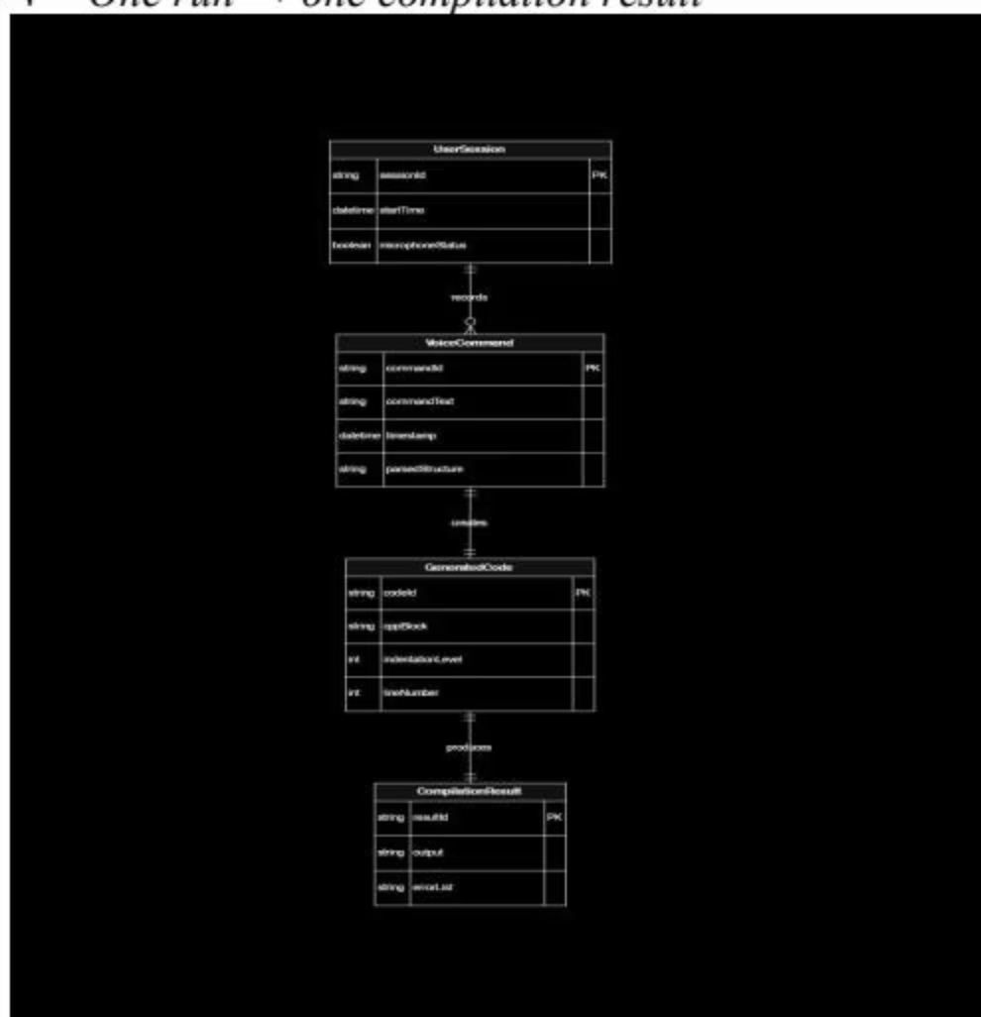
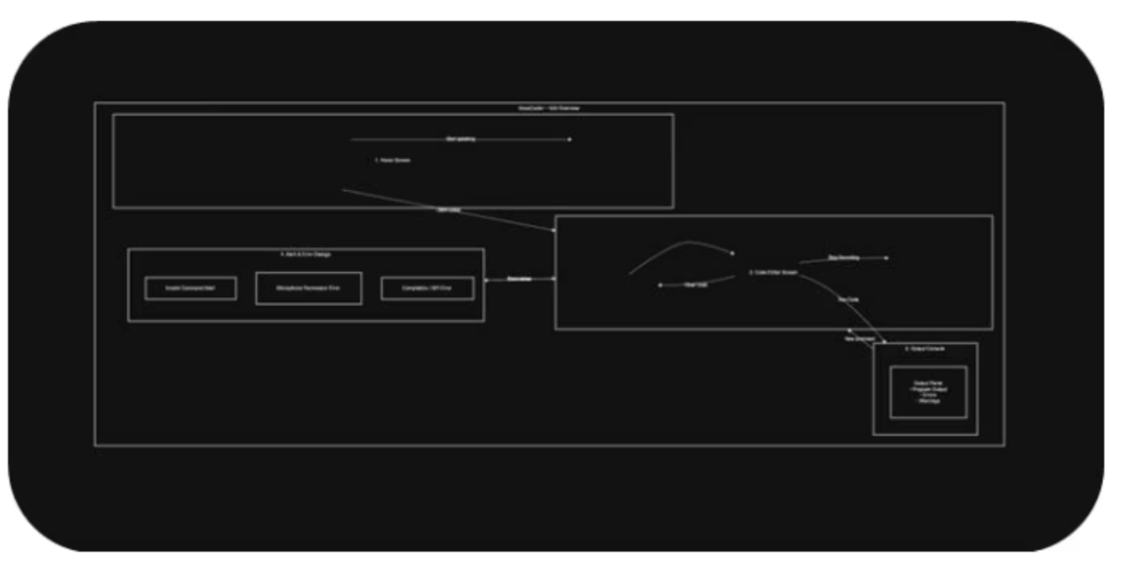
User Interface & Data Model
GUI Designs
Logical Data Model
Home Dashboard: "Voice Coding" banner, microphone button, waveform animation.
Entities include UserSession, VoiceCommand, GeneratedCode, and CompilationResult, defining relationships for data flow.
Code Editor Screen: Monaco Editor with dark theme, syntax highlighting, run/stop/clear buttons.
Output Console: Panel for results, warnings, and errors.
Error Popups: Notifications for invalid commands, API timeouts.
Figure 5.4: Logical Data Model (ERD)
Figure 5.3: VoiceCoder GUI Mockup

Slide 29

References
[1] I. Sommerville, Software Engineering, 10th ed. Boston, MA, USA: Pearson Education, 2016.
[2] R. S. Pressman and B. R. Maxim, Software Engineering: A Practitioner's Approach, 8th ed. New York, NY, USA: McGraw-Hill, 2015.
[3] E. Gamma, R. Helm, R. Johnson, and J. Vlissides, Design Patterns: Elements of Reusable Object-Oriented Software. Boston, MA, USA: Addison-Wesley, 1994.
[4] Mozilla Developer Network (MDN), "Web Speech API," Mozilla Foundation, 2024. [Online]. Available: https://developer.mozilla.org/en-US/docs/Web/API/Web_Speech_API
[5] Microsoft, "Monaco Editor Documentation," Microsoft Docs, 2024. [Online]. Available: https://microsoft.github.io/monaco-editor/
[6] Paiza, Inc., "Paiza.IO Online Compiler API Documentation," Paiza, 2024. [Online]. Available: https://paiza.io/en/api
[7] JDoodle, "JDoodle Compiler API Documentation," JDoodle, 2024. [Online]. Available: https://www.jdoodle.com/compiler-api
[8] Object Management Group (OMG), Unified Modeling Language (UML) Specification, Version 2.5.1, 2017.
[9] A. Dennis, B. Wixom, and D. Tegarden, Systems Analysis and Design: An Object-Oriented Approach with UML, 5th ed. Hoboken, NJ, USA: Wiley, 2015.
[10] D. Jurafsky and J. H. Martin, Speech and Language Processing, 3rd ed. Upper Saddle River, NJ, USA: Pearson, 2023.
[11] W3C, "Web Storage API Specification," World Wide Web Consortium, 2011. [Online]. Available: https://www.w3.org/TR/webstorage/
[12] N. Leveson, Safeware: System Safety and Computers. Reading, MA, USA: Addison-Wesley, 1995.
[13] ISO/IEC, ISO/IEC 25010:2011 – Systems and Software Quality Models, International Organization for Standardization, 2011.
[14] A. Silberschatz, P. B. Galvin, and G. Gagne, Operating System Concepts, 10th ed. Hoboken, NJ, USA: Wiley, 2018.

Slide 30
References
[15] J. Nielsen, Usability Engineering. San Francisco, CA, USA: Morgan Kaufmann, 1994.
[16] W3C, Web Content Accessibility Guidelines (WCAG) 2.1, W3C Recommendation, 2018. [Online]. Available: https://www.w3.org/TR/WCAG21/
[17] Apple Inc., "Voice User Interface Design Guidelines," Apple Human Interface Guidelines, 2024. [Online]. Available: https://developer.apple.com/design/humaninterface-guidelines/voice
[18] Google Developers, "Web Speech API Implementation Guide," Google Chrome Developers, 2024. [Online]. Available: https://developer.chrome.com/docs/web-platform/web-speech/
[19] A. Osmani, Learning JavaScript Design Patterns. Sebastopol, CA, USA: O'Reilly Media, 2017.
[20] IEEE, IEEE Standard for Information Technology—Systems Design—Software Design Descriptions, IEEE Std 1016-2009, 2009.
[21] B. Stroustrup, The C++ Programming Language, 4th ed. Boston, MA, USA: Addison-Wesley, 2013.
[22] ISO/IEC, Programming languages — C++, ISO/IEC 14882:2020, International Organization for Standardization, 2020.
[23] M. Fowler, Patterns of Enterprise Application Architecture. Boston, MA, USA: Addison-Wesley, 2002.
[24] I. Jacobson, G. Booch, and J. Rumbaugh, The Unified Software Development Process. Boston, MA, USA: Addison-Wesley, 1999.
[25] ECMA International, ECMAScript 2023 Language Specification, ECMA-262 14th Edition, 2023. [Online]. Available: https://www.ecma-international.org/publications-and-standards/standards/ecma-262/
[26] T. J. McCabe, "A Complexity Measure," IEEE Transactions on Software Engineering, vol. SE-2, no. 4, pp. 308-320, Dec. 1976.
[27] Microsoft Corporation, "N-tier architecture style," Microsoft Azure Architecture Guide, 2023. [Online]. Available: https://docs.microsoft.com/en-us/azure/architecture/guide/architecture-styles/n-tier
[28] World Health Organization, Global report on assistive technology, WHO, 2022. [Online]. Available: https://www.who.int/publications/i/item/9789240049451

